Slide 1

Scientific Group Benefits
Updated February 2025
All benefits are at the Company’s discretion and may change from time to time

Slide 2
Financial

Slide 3
Bonus
Scientific Group has introduced a discretionary bonus based on Company and individual performance
People must achieve a high score in performance reviews across all three criteria to be eligible for a bonus. Scoring will be done by line managers and discussed with department heads
The bonus covers the financial year ie July 2024 to June 2025
The bonus will be payable annually in December
The bonus will not be payable to those under notice to leave
The bonus will not be eligible to those in their probation period
T&Cs apply i.e. pro-rata bonus where appropriate for those who joined partway through the applicable financial year

Slide 4
Pension Scheme
The Company Group Scheme is with Aviva
Scientific Group offers an enhanced employer contribution, currently 4%
All eligible employees will automatically be enrolled in the scheme after an initial 3 month postponement period
We follow Government guidelines for employee contributions, currently 5%
The pension is managed through a salary exchange scheme
Further details are available

Slide 5
Group Income Protection
Group Income Protection is available to senior members of staff and Directors
The scheme is held with MetLife
If you are eligible, you will automatically be enrolled into the scheme
The benefit is effective after 6 month qualifying period
The benefit is equal to 75% of earnings less a fixed offset amount
The benefit payment period is state pension age

Slide 6
Group Life Assurance
Group Life Assurance, sometimes known as Death in Service, is available to all staff once they have completed their probation period
The scheme is held with MetLife
You are automatically enrolled into the scheme
The benefit is equal to 4 times your salary
The benefit payment period is to 65 or state pension age

Slide 7
Childcare Vouchers
Scientific Group offer Childcare Vouchers through Computershare Voucher Services
Depending on your circumstances, you can make considerable savings applying for childcare vouchers through the scheme
CCV will be suspended during various types of leave, including maternity and paternity leave, and sick leave when statutory sick pay is paid
Only existing members can participate in the scheme after changes by the Government
http://www.computersharevoucherservices.com/Pages/default.aspx
Unique employer’s reference number: 0014565635
If you need further information, Computershare Voucher Services would be happy to assist you with your inquiries by calling 0845 002 11 11

Slide 8
Cycle To Work Scheme
To join Cyclescheme, go to: http://www.cyclescheme.co.uk/bb38f4
Cyclescheme has many Partner Stores throughout UK. You visit one of the participating bike shops to select the bike and equipment that you want.
You will be given a quote, and you can use Cyclescheme's online tool to apply for your chosen package by entering the details online and requesting a secure voucher.
Once you have requested a secure voucher, Scientific Group will confirm eligibility and approve the request. Cyclescheme will send an invoice for the bike package, and a hire agreement is sent to you to sign. As soon as the bike is paid for, the secure voucher is sent to you.
Your hire payments are deducted from your gross monthly salary. At the end of the hire period Scientific Group has the option to offer the bike to you. If you want the bike you pay a Fair Market Value payment to own it outright.
Scientific Group reserves the right not to approve any requests for those still in their probation period.

Slide 9
Recruitment Incentive (page 1 of 2)
From time to time, someone you introduce to Scientific Group may be employed on a permanent basis. We trust your judgement as you have a clear understanding of our company values, culture, clients and projects.
We hugely appreciate introductions and to incentivise this, we have developed the following guidelines:
To qualify for the scheme, when introducing a colleague, you must notify HR and the line manager from the outset
The scheme or any earnings through the scheme do not constitute a contractual entitlement
If the individual is taken on a permanent basis, after the successful completion of their probation or after six months, whichever is longer, you will be awarded £2,000 gross or equivalent. This will be paid to you in your salary at the end of the following month

Slide 10
Page 2 of 2
If you wish to share the bonus with the person you have introduced, then we can arrange this at your discretion
This incentive is open to all employees, bar Directors
The recruitment decision will not be influenced by your introduction and no member of staff will be the sole interviewer of anyone that they have recommended personally
All incentive scheme payments are discretionary, subject to change or withdrawal at any time
An individual will not receive the incentive if they or the employee they have introduced is under notice to leave the Company
Former staff are not eligible to be included in the introductory scheme
The Company reserves the right to review and amend this procedure at their discretion.

Slide 11
Perkbox
Perk Box is a benefits App that provide discounts and personalised benefits to all UK employees.
You are awarded 40 points each month by the company which are added to your Perkbox balance, feel free to save or spend as you please!
It is up to the individual what they wish to take advantage of – from discounted cinema tickets, free mobile phone insurance, free car breakdown cover, reduced gym membership, Café Nero freebies – the list is endless!

Slide 12
Travel card loan
Scientific Group offers all employees, once they have successfully completed their probation period, an interest free travel card loan
To take advantage of this loan, complete the form found on the intranet, and return it to the P&C department
The loan will be paid directly to the train company on your behalf and then deducted from your salary in 10 equal instalments.

Slide 13
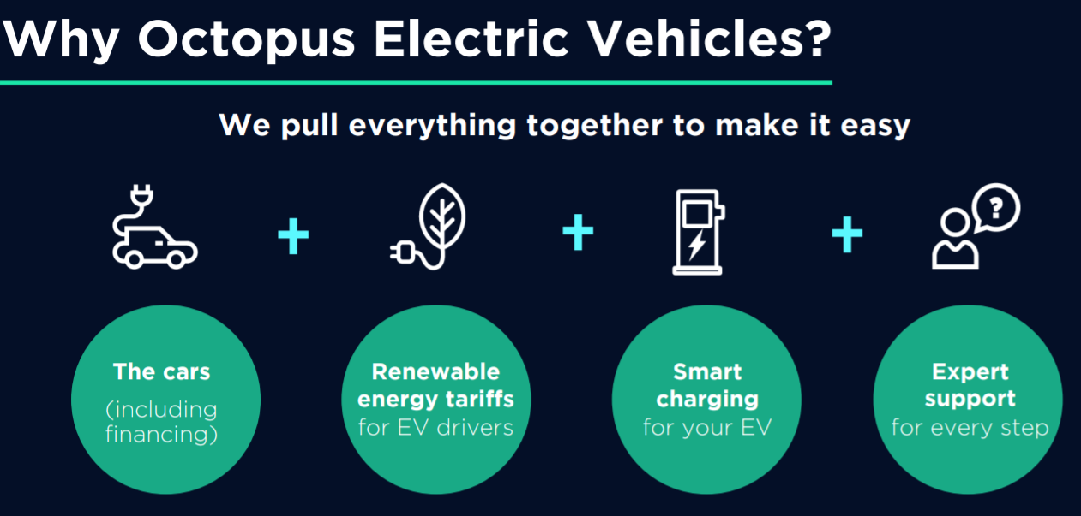
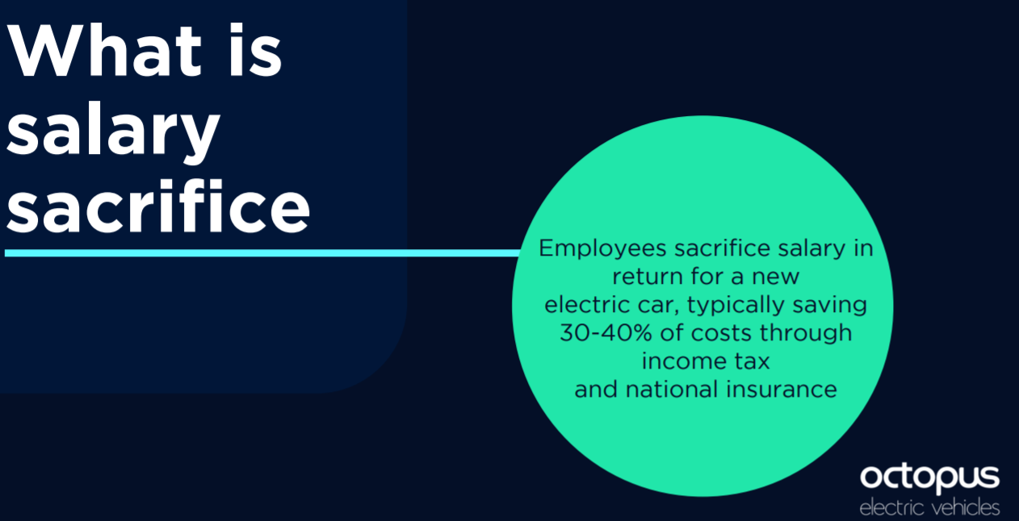
Electric cars
Scientific Group have partnered with Octopus energy to offer a salary exchange scheme to purchase an electric car
Full details can be found on the Sharepoint
Use code: ASK1629

Slide 14
Health & Wellness

Slide 15
Family Friendly
Scientific Group offers enhanced family friendly support including maternity, paternity and parental leave
For further details see the Family Friendly policy

Slide 16
Aviva Private Medical Cover
All UK employees will be enrolled into the Aviva Private Medical Scheme
All staff are eligible once they have completed their probation period
This is the only taxable benefit we offer, therefore if you wish to opt out, please notify us in writing
Aviva will contact you directly with the membership pack and login details

Slide 17
Headspace
To promote wellbeing in and outside of work, we offer a free subscription to Headspace, available to all permanent employees
All you need is your work email to join! You can link an existing account or sign up at: https://work.headspace.com/ask/member-enroll/verify

Slide 18
Holiday
Holiday entitlement is 25 days per year plus 8 Bank Holidays (pro rata for part-time employees). The holiday year runs from January to December and if you join part way through the year, your holiday is pro rata
All holiday must be recorded on CMap
As your length of service increases, to thank you for your commitment, so does your holiday entitlement. You get 25 days per year, plus an extra day for every year you’ve been here from 3 years onwards, up to a maximum of 30

Slide 19
Sustainable Travel
As a Climate Perks accredited employer, we offer paid travel time where employees elect to travel via land or sea rather than via air
The paid travel time can be claimed for additional hours spent travelling, in accordance with the provisions of this policy
The maximum travel time that can be reclaimed is two working days in any one ‘travel time year’
For further detail, see the policy on Knowledge Central

Slide 20
Eye care test
It is essential we all look after our eyesight, and so all DSE users are eligible for an annual eye test
Recommended cost of an eye test is approximately £30
Vision Express are offering a deal via PerkBox
If you require glasses for VDU only, Scientific Group will contribute a maximum of £100

Slide 21
Employee Assistance Programme
What can I use this service for?
Unlimited free access to a 24/7, 365 confidential helpline
Free access to 24/7 critical incident and trauma support
If you speak with Vivup over the phone, make sure you quote Perkbox
Receive online help and support via an online portal
Medical, legal and financial information
Eldercare and childcare guidance
The service is provided in confidence and anonymity is assured at all times
Access this via PerkBox https://scientificgroup.perkbox.com/perks/info/vivup-eap-enhanced-uk

Slide 22
Volunteer Day
Everyone is entitled to a “Volunteer Day” per year
This day is paid as usual and in addition to your holiday entitlement
Simply arrange with your manager and team, when you wish to take your Volunteer Day
Ensure this is recorded on CMap
Volunteer with an organisation or charity of our choice
Share it with us – photo, what it means to you
Enjoy!

Slide 23
Social

Slide 24
Social Committee
Our Social Committee arrange an array of experiences for us to celebrate at Scientific Group
If you would like to join the Committee or have any potential ideas then do let the social committee know
We celebrate with a fantastic Christmas Party and Summer Party!
We also support several charitable events and details will be sent round such as MacMillan Coffee Mornings

